Slide 1
Hidden Markov Model
HMM

Slide 2
Intuition behind HMMs
HMMs are probabilistic models and a graphical model.
It help is to predict sequence of unknown variables from a set of observed variables
They allow us to compute the joint probability of a set of hidden states given a set of observed states. The hidden states are also referred to as latent states. Once we know the joint probability of a sequence of hidden states, we determine the best possible sequence i.e. the sequence with the highest probability and choose that sequence as the best sequence of hidden states.
In order to compute the joint probability of a sequence of hidden states, we need to assemble three types of information which the transition data, emission data and initial probabilities.
Generally, the term “states” are used to refer to the hidden states and “observations” are used to refer to the observed states.
Notes:
For sequential data and temporal data: discrete time series data
Simple and powerful
Computes prob or distribution of events that is observed
Statistical model

Slide 3
Advantages
HMM is an analyzed probabilistic graphical model. The algorithms applied in this model are studied for approximate learning and conclusion.
Hidden Markov Models (HMM) are said to acquire the contingency between successive measurements, as defined in the switch continuity principle.
HMMs represent the variance of appliances’ power demands via probability distributions.
Disadvantages
HMM cannot represent any dependency between the appliances. The conditional HMM can capture the dependencies, though.
HMM does not consider the state sequence dominating any given state because of its Markovian nature.
HMMs do not explicitly capture the time in a specified state due to their Markovian behavior. Nonetheless, the hidden semi-Markov model is responsible for capturing that kind of behavior.

Slide 4
Hidden Markov Model (HMM) is a statistical Markov model in which the system being modeled is assumed to be a Markov process with unobserved (i.e. hidden) states.
HMM are used for sequential data or temporal data( discrete time series data)
Hidden Markov models are especially known for their application in reinforcement learning and temporal pattern recognition such as speech, handwriting, gesture recognition, part-of-speech tagging, musical score following, partial discharges and bioinformatics.

Slide 5
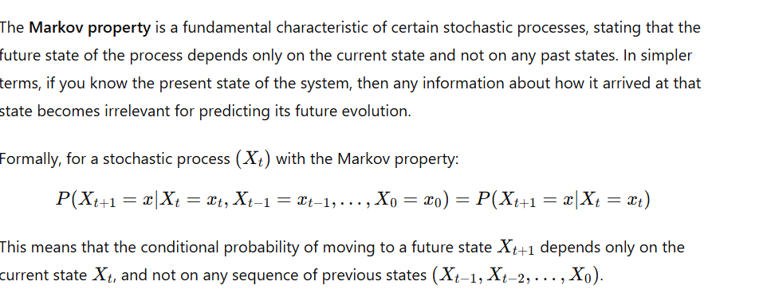
Markov Property

Slide 6
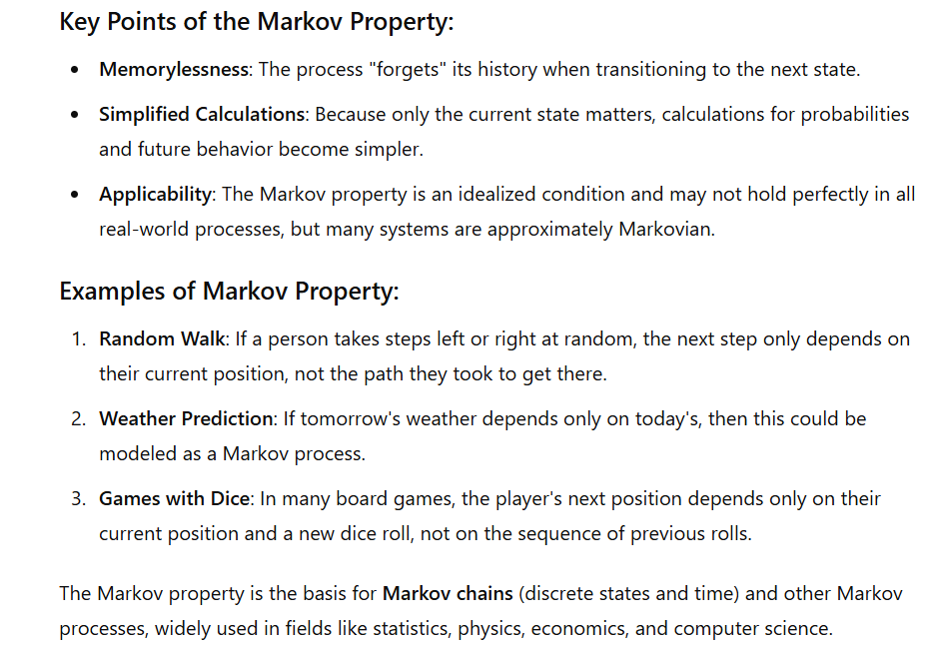

Slide 7
A Markov Chain is a mathematical model that represents a sequence of possible events where the probability of each event depends only on the state of the previous event. It’s a type of stochastic (random) process that follows the Markov property — the principle that "the future state depends only on the present state and not on the sequence of events that preceded it."
Key Characteristics of a Markov Chain
States: Each possible event or situation in the process is called a "state."
Transition Probability: The probability of moving from one state to another is fixed and represented by a transition probability matrix.
Memoryless (Markov Property): The outcome of the next state depends only on the current state and not on the previous states before it.

Slide 8
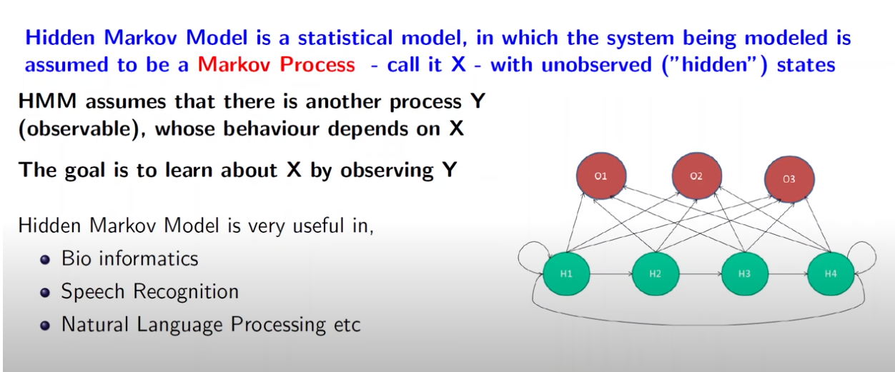
Notes:
Markov process is a stochastic process in which the distribution of future event depend on the current event

Slide 9
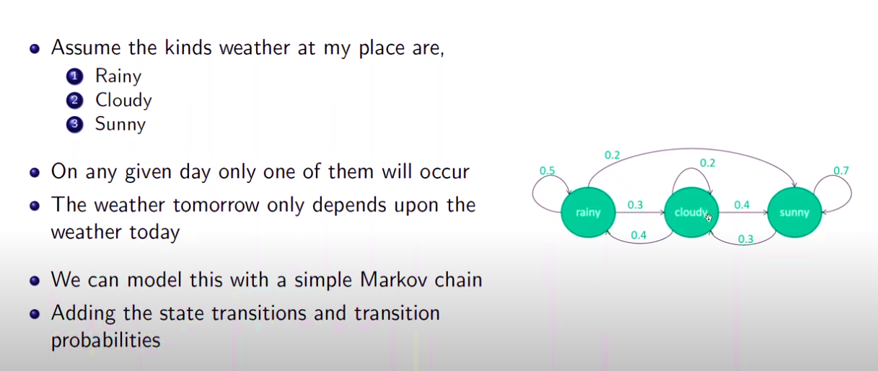
Markov model

Slide 10
Markov chain or Markov process
A Markov chain or Markov process is a stochastic model describing a sequence of possible events in which the probability of each event depends only on the state attained in the previous event.
Future state depends on just the current/present state
The chain that follows Markov property, it is called Markov chain.

Slide 11
Hidden Markov Model (HMM)
Hidden Markov Model (HMM) is a statistical model that is used to describe the probabilistic relationship between a sequence of observations and a sequence of hidden states. It is often used in situations where the underlying system or process that generates the observations is unknown or hidden, hence it got the name “Hidden Markov Model.”
It is used to predict future observations or classify sequences, based on the underlying hidden process that generates the data.
An HMM consists of two types of variables: hidden states and observations.
The hidden states are the underlying variables that generate the observed data, but they are not directly observable.
The observations are the variables that are measured and observed.
The relationship between the hidden states and the observations is modeled using a probability distribution. The Hidden Markov Model (HMM) is the relationship between the hidden states and the observations using two sets of probabilities: the transition probabilities and the emission probabilities.

Slide 12
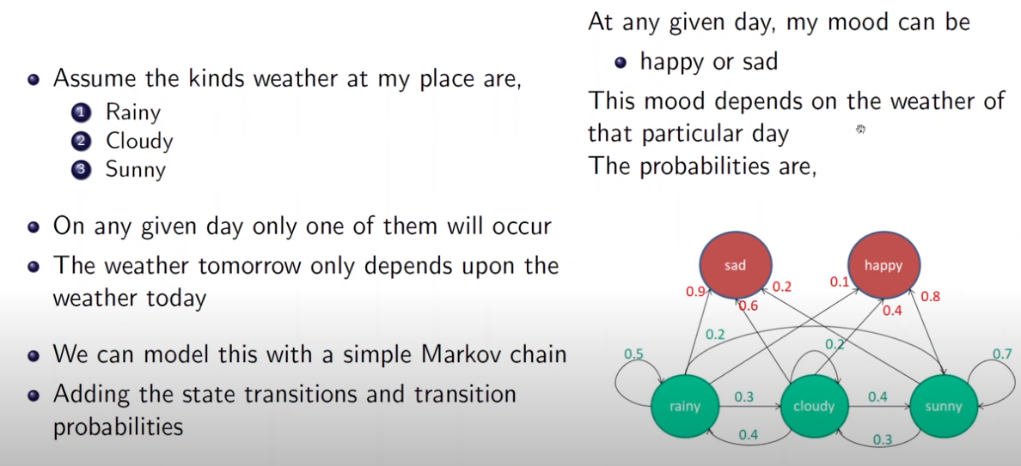
Sad and happy: observed states
Rainy, Cloudy, Sunny: hidden states

Slide 13
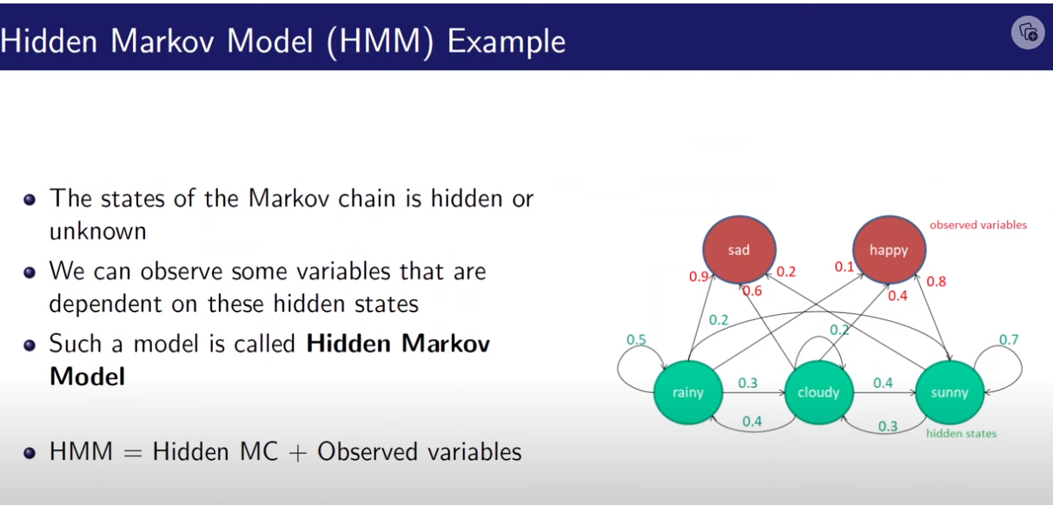

Slide 14
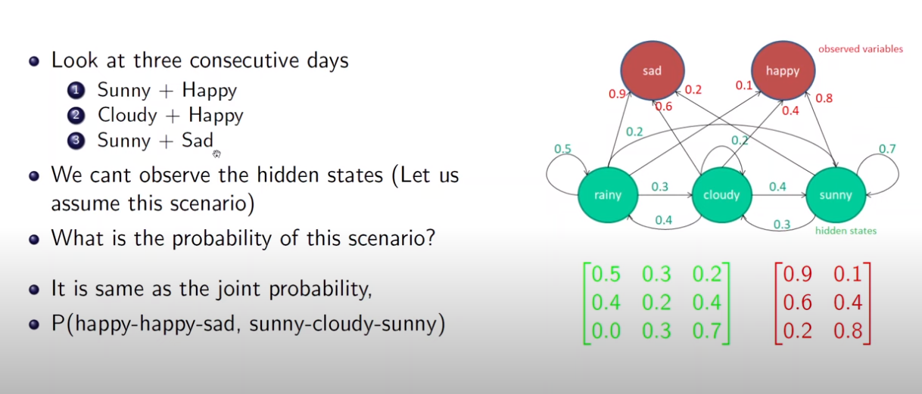

Slide 15
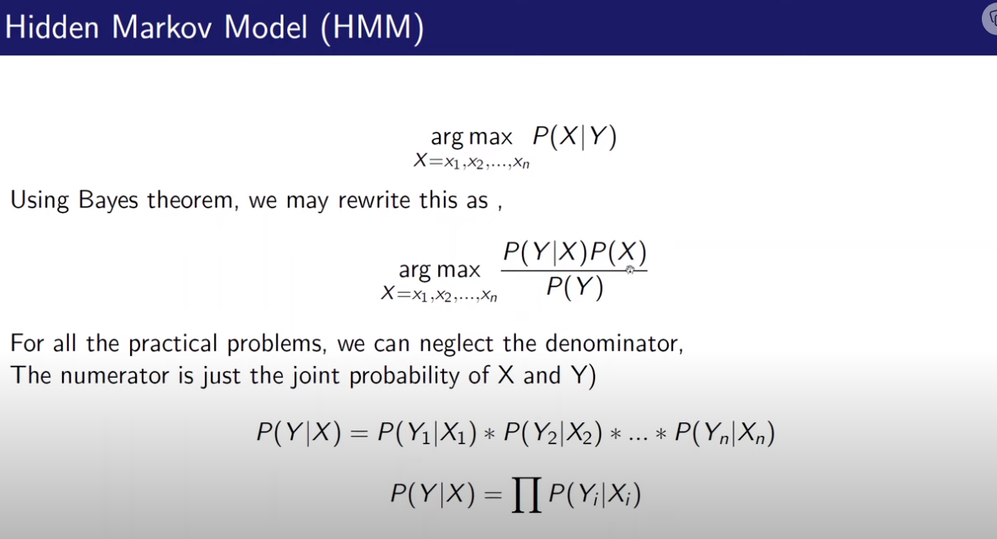

Slide 16

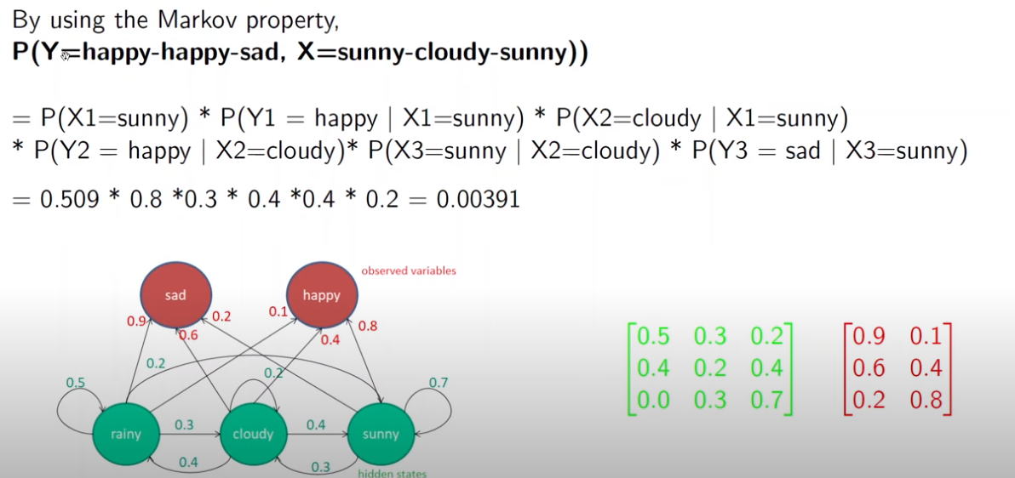
Initial prob of sunny is given
rainy
cloudy
sunny
sad
Happy
rainy
rainy
cloudy
cloudy
Sunny
Sunny

Slide 17
Reference
Three Basic Problems of Hidden Markov Model

Slide 18
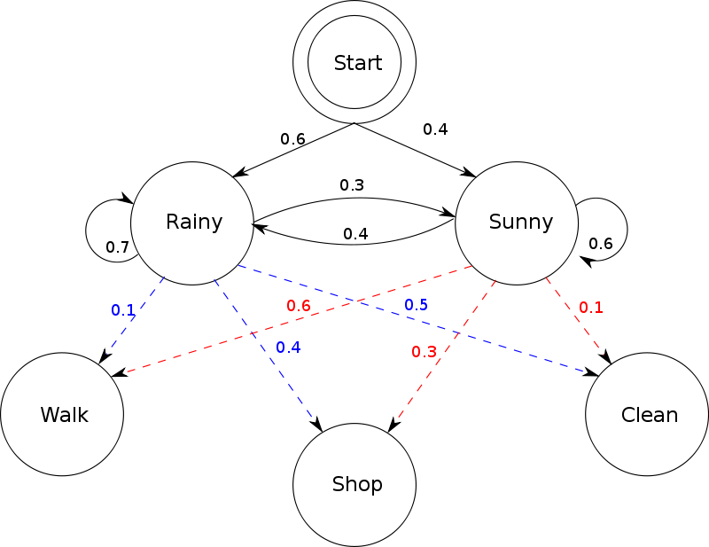
Hidden Markov Model
Markov property
Memory less- At a time only one state is considered.
For prediction consider only present state.
When a machine is in any state, it always emits a visible state
Initial probability
State transition probabilities
Hidden state
or latent states.
Given any state there will always be a transition to other states , including state itself
Emission probability between hidden and visible state
Walk, shop, clean: visible states, observable states
Notes:
Statistical model, model generation based upon set of input sequence, Identifies sequences, finite state machines, finites states, machines make transitions between these states.
Set of output and input symbols.
Markov property: memory less-consider only one state, current state depends on previous state. Future prediction based on present state. No past no future.

Slide 19
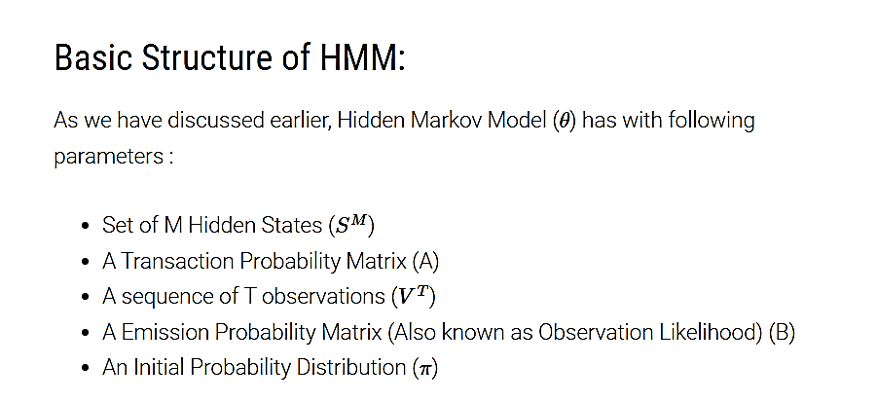

Slide 20
Understanding hidden Markov models
A Hidden Markov Model consists of several components that capture the underlying patterns in sequential data.
Start state
The start state represents the initial state of the model. It is the starting point from which the sequence of hidden and observed states begins. The start state is associated with a start probability, which indicates the likelihood of starting the sequence from a particular hidden state.
Hidden state
Hidden state represents the unobservable or latent state of a system. This characterizes the underlying dynamics or processes being modeled. Hidden states can be concepts, variables, or phenomena that are not directly accessible but influence the observed states.
Observed states
Observed or emitted states are each hidden state’s measurable or observable outcomes. They represent the data or information that is available for analysis. The underlying hidden states influence the observed states and provide indirect insights into the hidden processes.

Slide 21
Start probabilities
Start probabilities represent the initial probabilities of being in each hidden state at the start of the sequence. These probabilities reflect the likelihood of starting the sequence from a specific hidden state.
Transition probabilities
Transition probabilities describe the likelihood of transitioning from one hidden state to another. They capture the system’s dynamics and represent the probabilities of moving between hidden states at each time step. Transition probabilities in an HMM are typically modeled as conditional probabilities based on the previous hidden state.
Emission probabilities
Emission probabilities define the probability distribution of observing a particular state given the current hidden state. They represent the relationship between hidden states and observed states. Emission probabilities specify the likelihood of generating a specific observed state from a particular hidden state. These probabilities can be used to infer the underlying hidden states based on the observed data.
The illustration below depicts a simple example of an HMM containing the categories mentioned above:

Slide 22
An HMM consists of two types of variables: hidden states and observations. The hidden states are the underlying variables that generate the observed data, but they are not directly observable. The observations are the variables that are measured and observed

Slide 23
Terminology in HMM
The term hidden refers to the first order Markov process behind the observation. Observation refers to the data we know and can observe. Markov process is shown by the interaction between “Rainy” and “Sunny” and each of these are HIDDEN STATES.
OBSERVATIONS are known data and refers to “Walk”, “Shop”, and “Clean” in the above diagram. In machine learning sense, observation is our training data, and the number of hidden states is our hyper parameter for our model.

Slide 24
What is hidden
Refers to the state sequence through which the model passes.
Property of HMM:
Memory less- Takes only one state which is normally the current state and the prediction can be only be based on the present state.
Sum of all emission probabilities is 1
Sum of all transition probabilities also 1
Each next state depends upon the previous state only.
P(q1, q2, q3…qn)= p(q1)*p(q2|q1)* p(q3|q2)*….

Slide 25
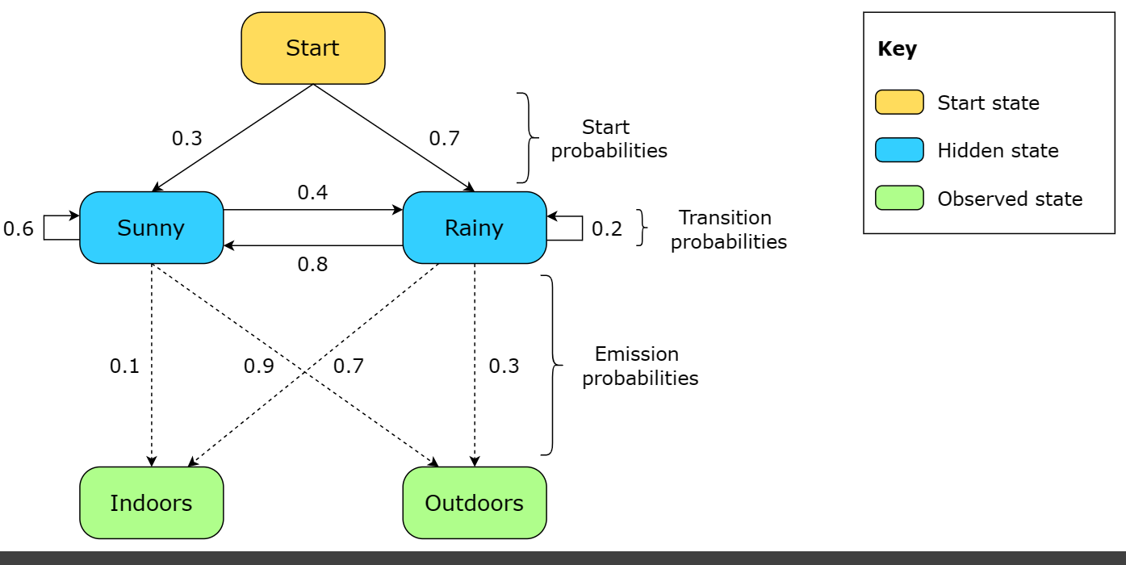

Slide 26
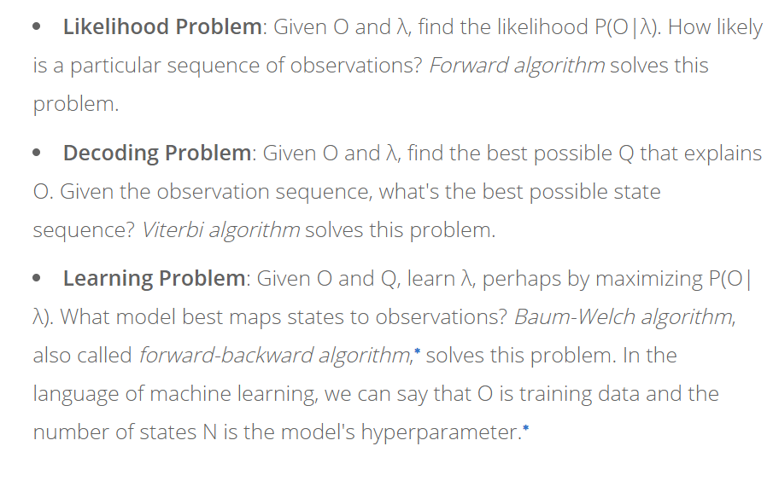
HMM can be used to solve these types of problems(important)

Slide 27
Transition table
tomorrow
 | Rainy (S1) | Cloudy (S2) | Sunny (S3)
Rainy (S1) | 0.4 | 0.3 | 0.3
Cloudy (S2) | 0.2 | 0.6 | 0.2
Sunny (S3) | 0.1 | 0.1 | 0.8
Today
Q1: Make the Hidden Markov model
Q2: what is the probability of having 6 days weather like :
Day1: cloudy
Dat2: rainy
Day3: rainy
Day4: sunny
Day5: cloudy
Day6: sunny
Its given that todays weather is sunny
The states are:
S1: Rainy
S2: Cloudy
S3: Sunny

Slide 28
Why Hidden Markov Model?
The reason it is called a Hidden Markov Model is because we are constructing an inference model based on the assumptions of a Markov process. The Markov process assumption is simply that the “future is independent of the past given the present”. In other words, assuming we know our present state, we do not need any other historical information to predict the future state.
To make this point clear, let us consider the scenario below where the weather, the hidden variable, can be hot, mild or cold and the observed variables are the type of clothing worn. The arrows represent transitions from a hidden state to another hidden state or from a hidden state to an observed variable.

Slide 29
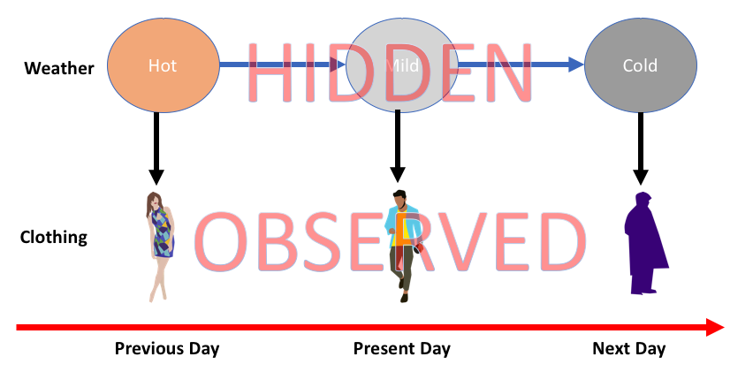
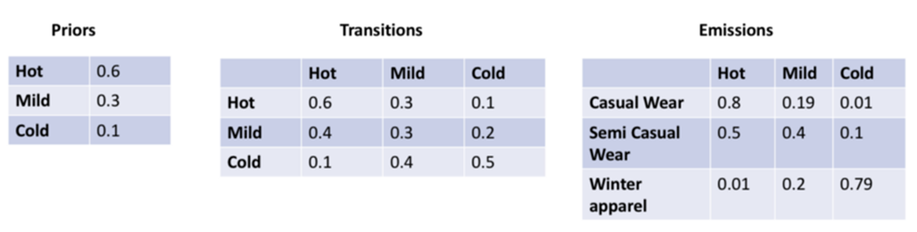
Casual wear
Semi-Casual wear
Winter wear
Notice that, true to the Markov assumption, each state only depends on the previous state and not on any other prior states.

Slide 30
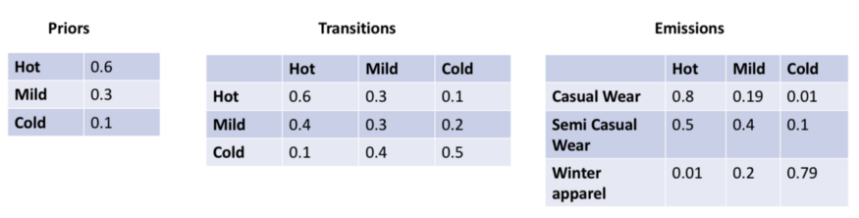
Prior probability, transition and emission probabilities

Slide 31
Transition data — the probability of transitioning to a new state conditioned on a present state.
Emission data — the probability of transitioning to an observed state conditioned on a hidden state.
Initial state information — the initial probability of transitioning to a hidden state. This can also be looked at as the prior probability.

Slide 32
Applications of hidden Markov models
HMMs have a wide range of applications across various domains. Here are four real-life applications of HMMs, along with explanations of the hidden and observed states in each case.
Speech recognition
HMMs can model the relationship between the hidden linguistic units (hidden states) and the observed acoustic features in speech recognition.
Hidden states: Phonemes or linguistic units representing the underlying speech sounds
Observed states: Acoustic features such as mel-frequency cepstral coefficients (MFCCs) or filterbank energies obtained from the audio signal
The model captures the probabilistic transitions between different phonemes or linguistic units based on the observed audio signal.
Parts of speech tagging
In parts of speech tagging, HMMs can be employed to predict the grammatical category of each word in a sentence.
Hidden states: Grammatical categories or parts of speech (e.g., noun, verb, adjective)
Observed states: Words or tokens in a sentence
The hidden states represent the underlying parts of speech, while the observed states are the words in the sentence. The HMM models the probabilistic transitions between different parts of speech based on observed words.

Slide 33
Gesture recognition
HMMs can be used to recognize gestures based on observed movements.
Hidden states: Gesture classes or types (e.g., swipe, tap, pinch)
Observed states: Time-series data of hand or body movements captured by sensors or cameras
The hidden states represent different gesture classes, while the observed states are the time-series data capturing the hand or body movements. The HMM model captures the probabilistic transitions between different gestures based on the observed movement patterns.
Stock market analysis
HMMs can be employed in stock market analysis to model different market regimes based on observed financial indicators.
Hidden states: Market regimes or states (e.g., bull market, bear market, volatile market)
Observed states: For historical financial indicators such as stock prices, trading volumes, or technical indicators
The hidden states represent the underlying market states, while the observed states are historical financial indicators. The HMM model captures the probabilistic transitions between market regimes based on observed indicators.

Slide 34
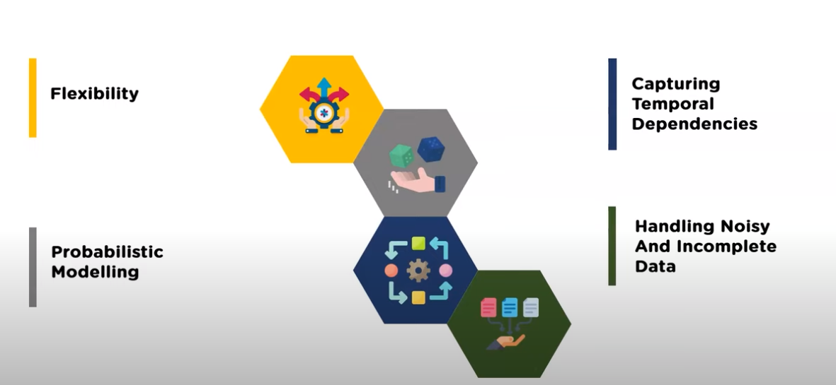

Slide 35
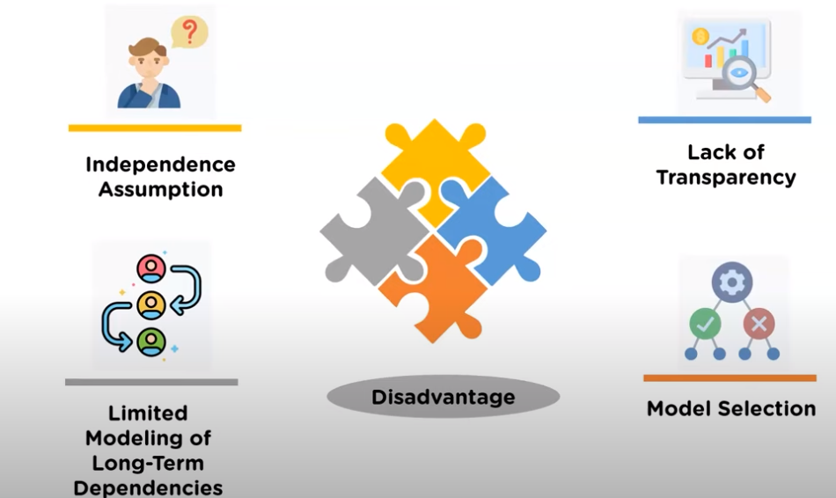
Disadvantage of HMM

Slide 36
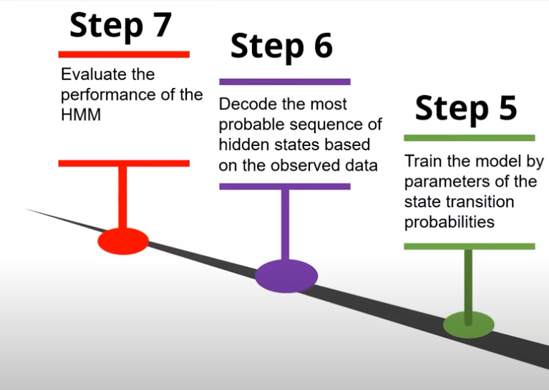
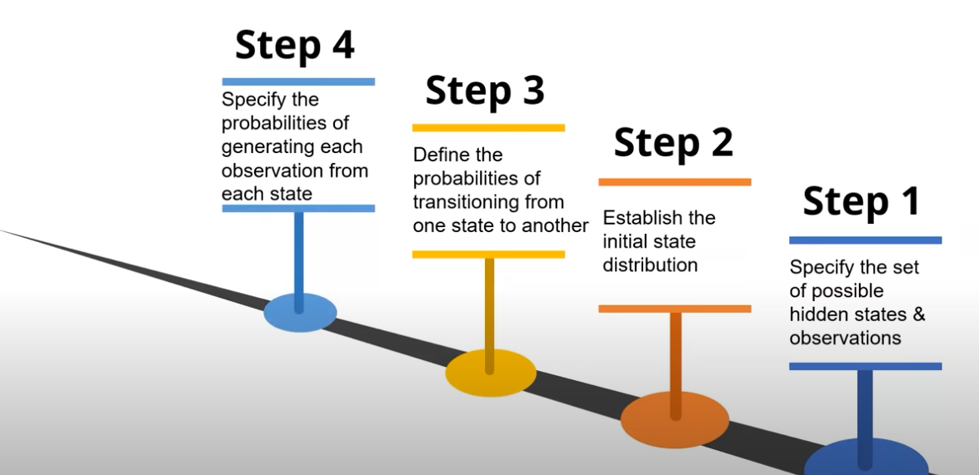
Steps of HMM

